Slide 1
CHECKPOINT 3
BY BATCH I GROUP 5
CAPSTONE PROJECT (LOAN DATA)

Slide 2
TEAM MEMBER RESPONSIBILITIES
Task 3.1 : Jayanth, Rimjhim, Chinmay
Auxiliary Helper : Narayani, Shubhaditya (Could not contribute much due to knee surgery)
Task 3.2 : Narayani
Auxiliary Helper : Rimjhim, Jayanth
Task 3.3 : Jayanth, Rimjhim
Auxiliary Helper : Shubhaditya, Narayani

Slide 3
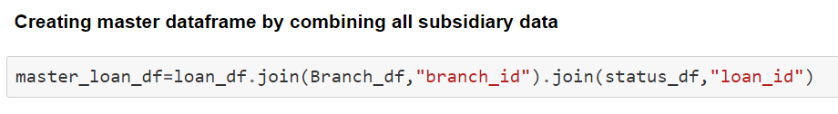
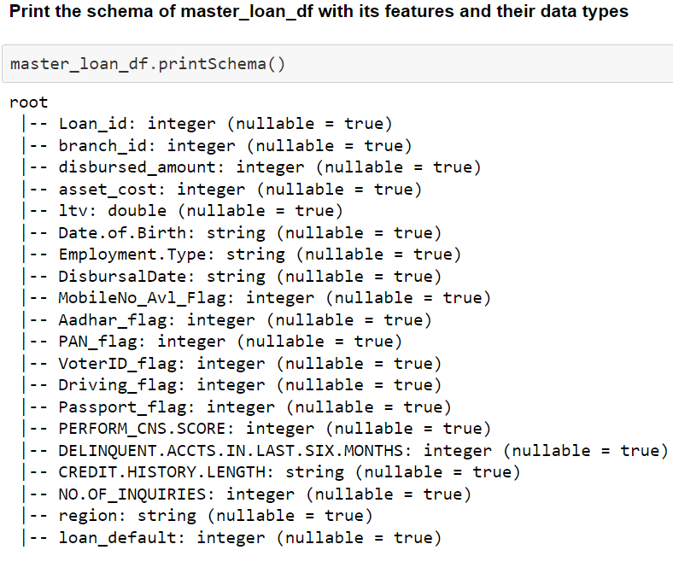
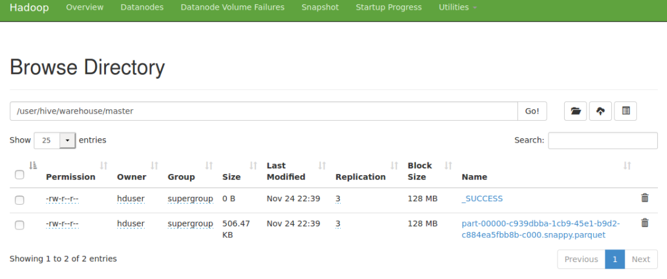
3.1 Data Analysis using Big Data Tools
1. PySpark application to load the Spark Data Frames and infer the schema.
2. Save the master_loan_df into Hive tables on a Hadoop cluster in an optimized format.
The optimized format for data storing on a Hadoop cluster is parquet format. Parquet is a compressed columnar data format developed for use in any Hadoop based system. It is supported in spark.

Slide 4
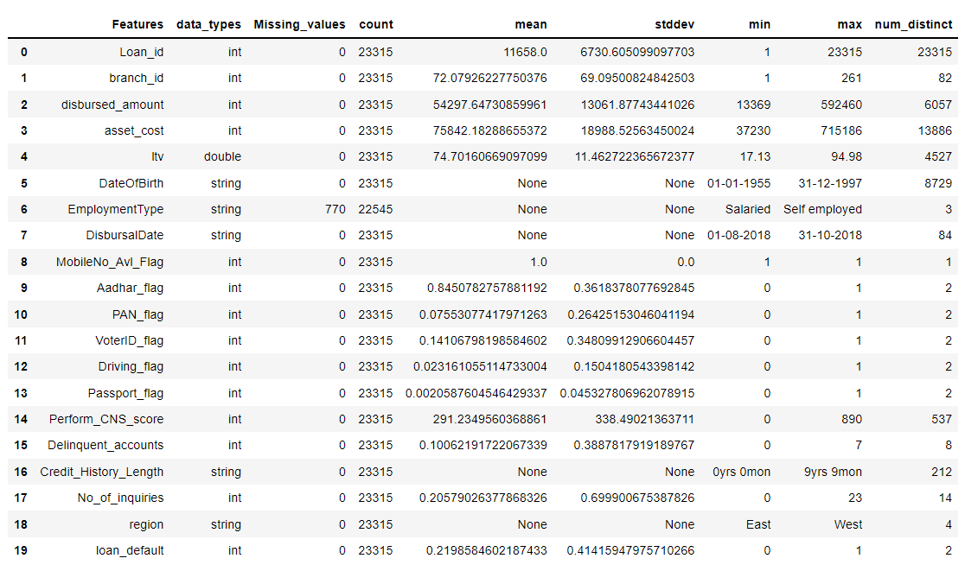
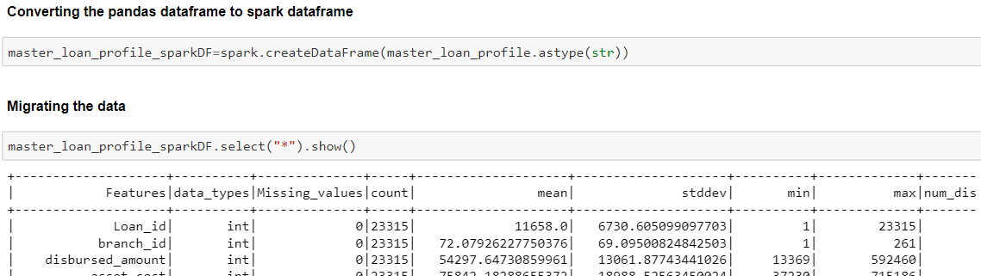
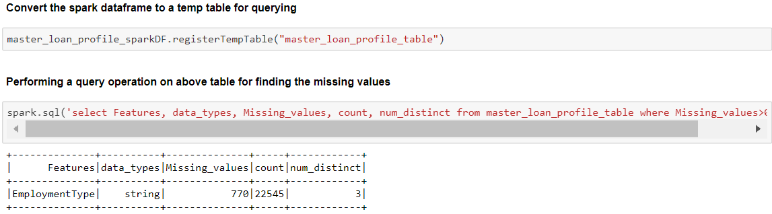
3. Perform profiling of the data through PySpark.
4. Ensure that the profiled data through
Pyspark is migrated correctly wherever
the source is an RDBMS.

Slide 5
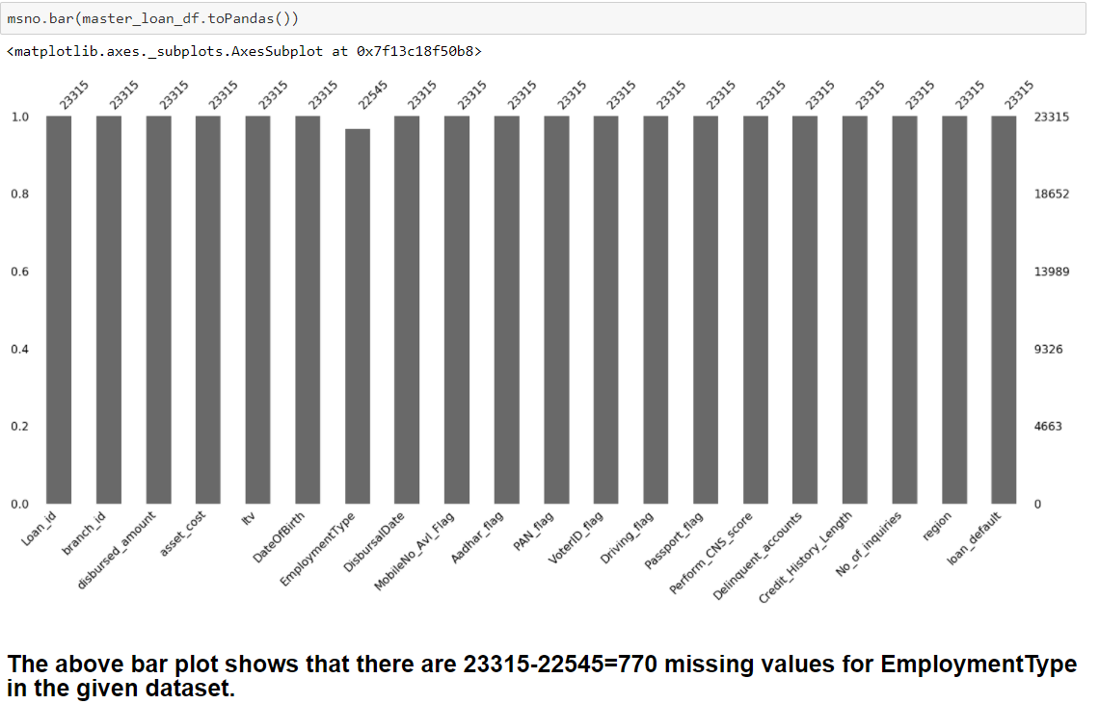
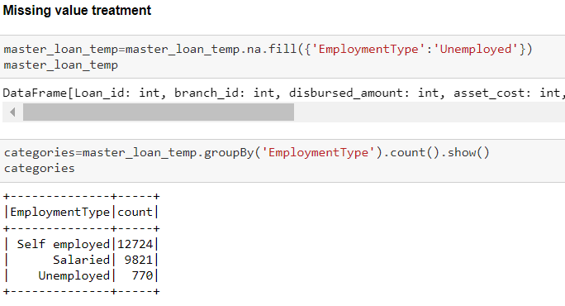
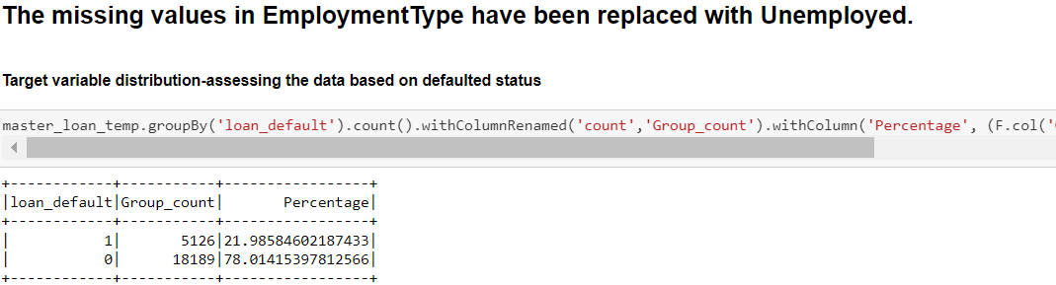
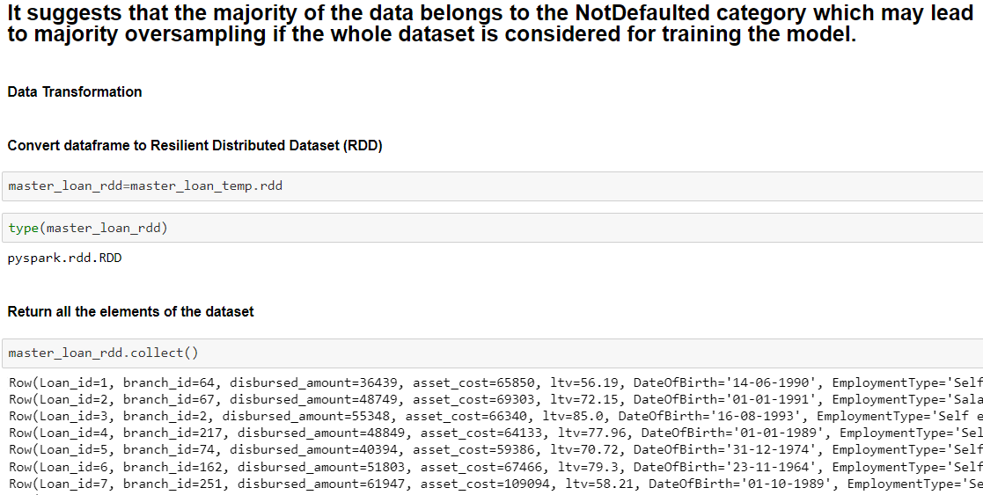
5. Write PySpark routines to cleanse the data, prepare the data to handle missing values, and the data transformations identified in task 1.1 again making sure that the data is written into Hive tables in an efficient format.

Slide 6
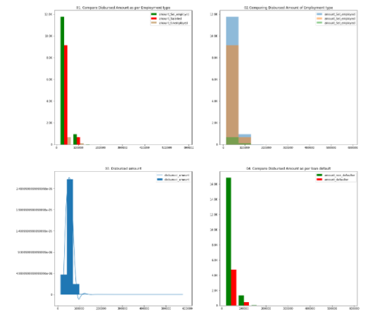
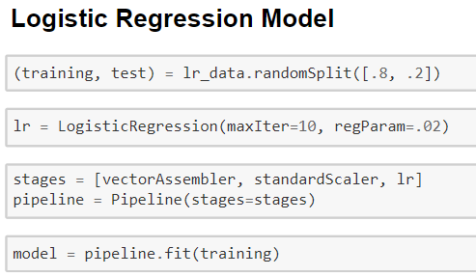
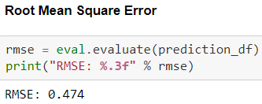
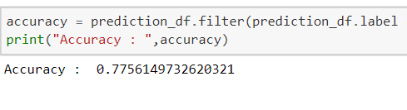
6. Data Visualizations
7. If the predictive model identified in task 2.4 available in Spark MLlib then develop a PySpark application to implement and evaluate the ML model identified with appropriate metrics.
Model 1 - Logistic Regression model

Slide 7
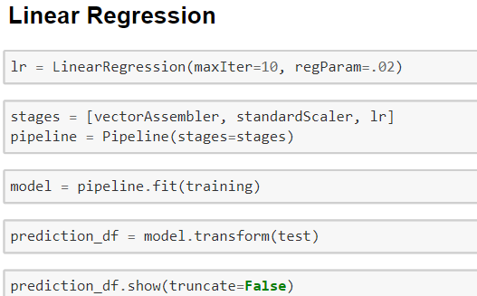
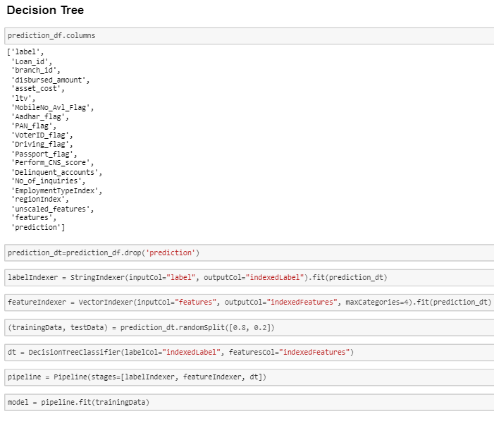
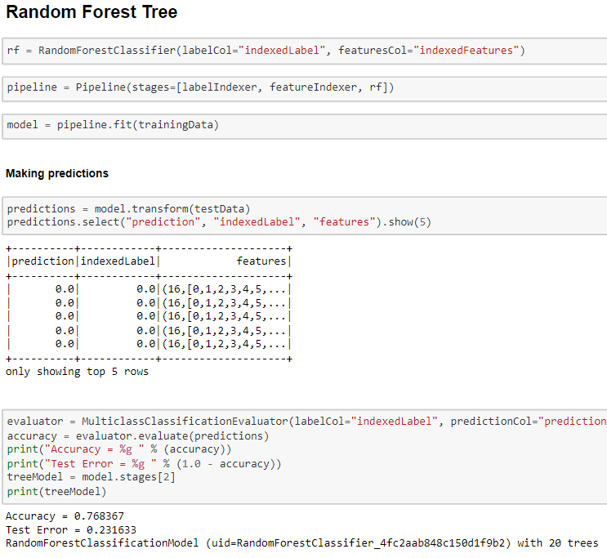
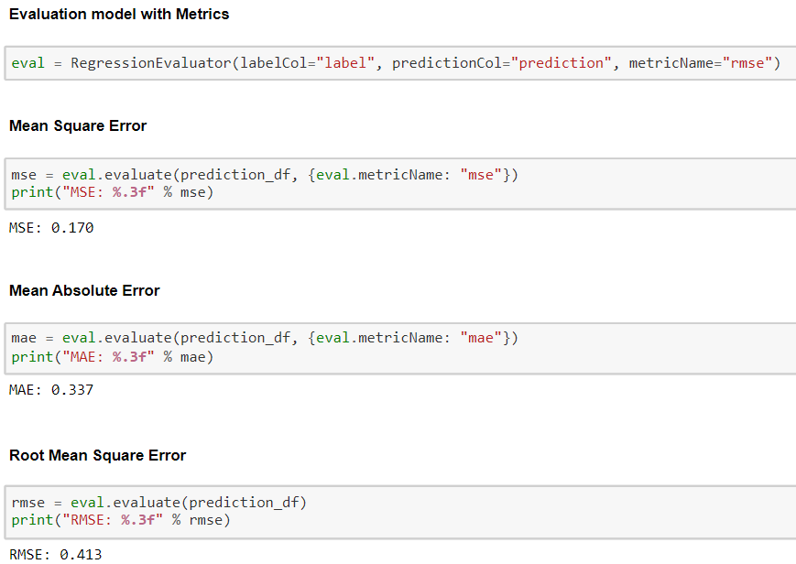
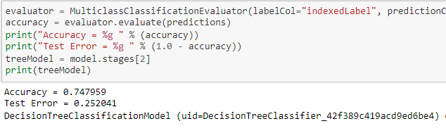
Model 2 - Linear Regression model
Model 3 – Decision Tree model
Model 4 – Random Forest Tree model
Using above 4 models, the accuracy was maximum in case of Logistic Regression Model with 77%. The Root Mean Square Error is nearly the same for both Logistic and Linear Regression Model. So we suggest using Logistic Regression for the given dataset.

Slide 8
3.2 Data Analysis on Cloud
Move Dataset to Azure Synapse Storage Gen 2
Create a Serverless SQL pool to query data from Gen 2
Create a Linked service to Power BI
Perform various analytics on Power BI
Ensure you have sufficient privileges on synapse
Perform tasks mentioned in Task 2.3

Slide 9
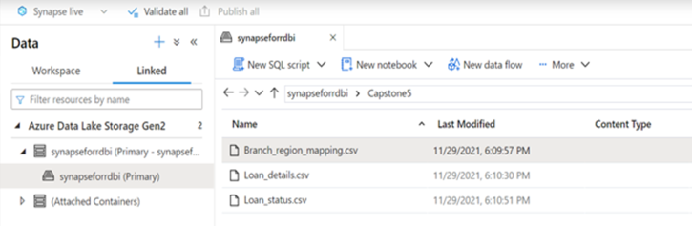
To moving dataset to Azure Synapse storage Gen 2 :
We used synapsefordbi instance which was given already.
Next, we created folder Capstone5, to upload data files from the local system to Azure storage.
Uploaded 3 .csv files (Loan Data)

Slide 10
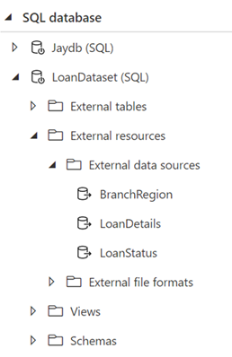
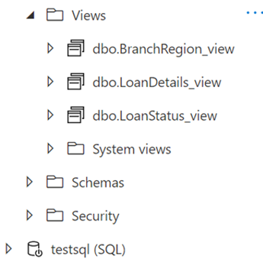
2. Next is, create serverless SQL pool from storage Gen 2
Once the pool is created, we create three external data sources one for each data file.
After this, three views have been built for each external data source.

Slide 11
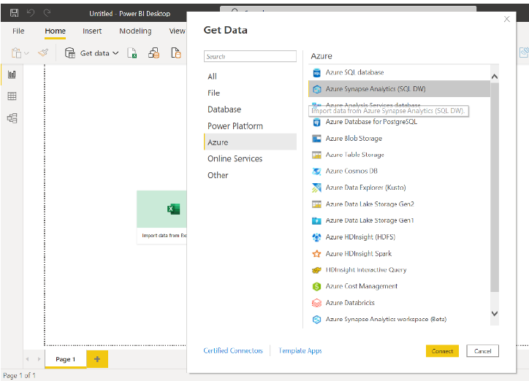
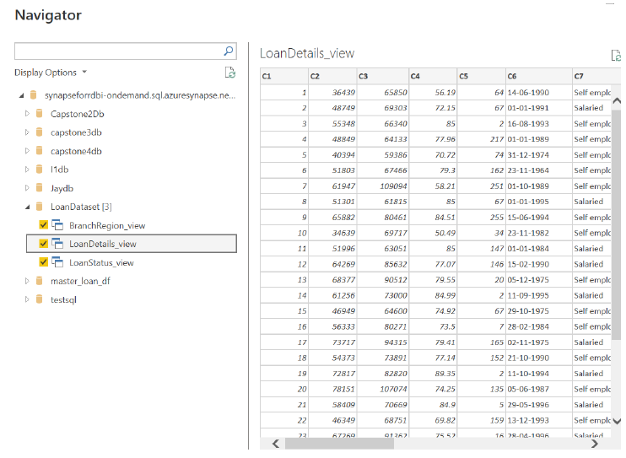
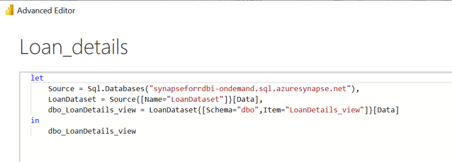
3. Created Linked service to Power BI
We took the serverless SQL end point and used that to connect Azure Synapse Storage with desktop Power Bi.
Received data from Azure Storage to desktop Power Bi, by selecting Get Data from Azure.
Once dataset is loaded, we will be able to see data in desktop Power Bi.

Slide 12
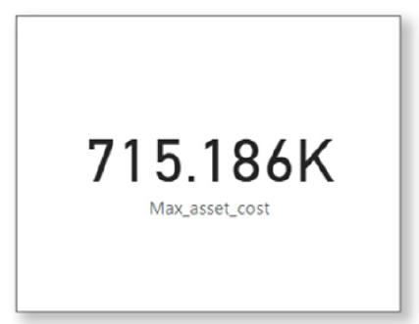
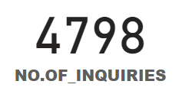
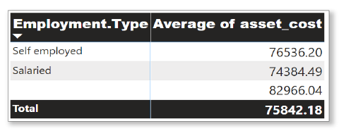
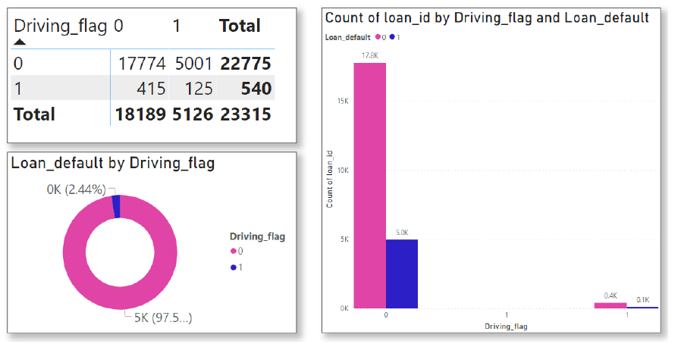
4. Performed various analytics (tasks) given in task 2.3
Tasks given in 2.3 are:
What were the total enquiries done?
What is the average asset cost What is the average loan default
for each employment type? for each driving flag?
What was the maximum asset cost?

Slide 13
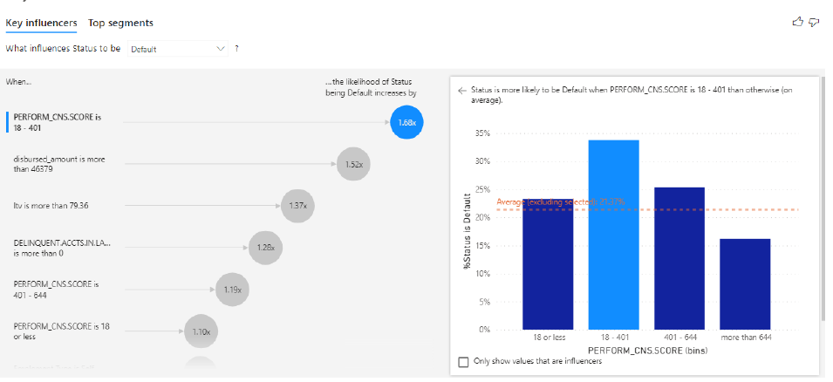
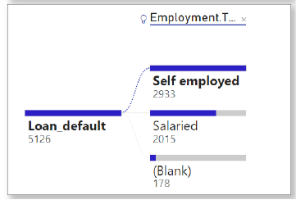
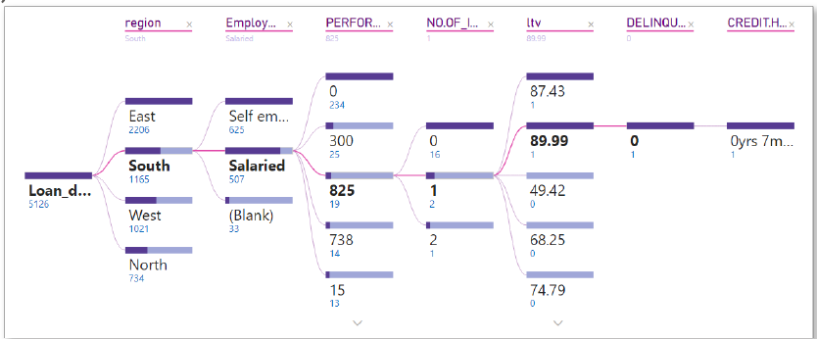
Display to Key Influencer Visual.
Display a Decomposition Tree for the data.
Display loan default by employment type.

Slide 14
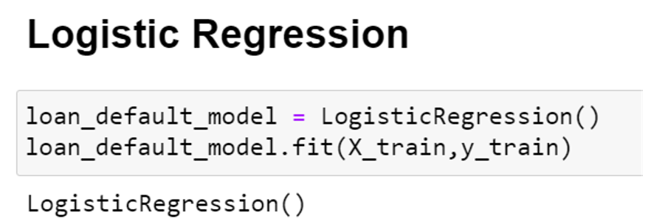
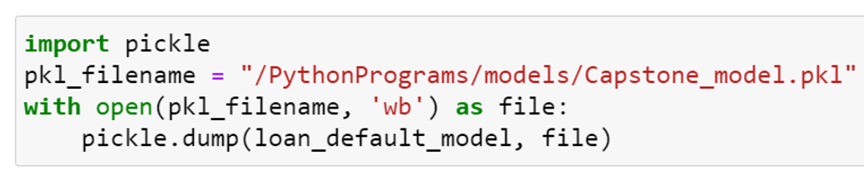
3.3 Deployment of Model using Flask
Logistic Regression Model
Generating the pickle file
G

Slide 15
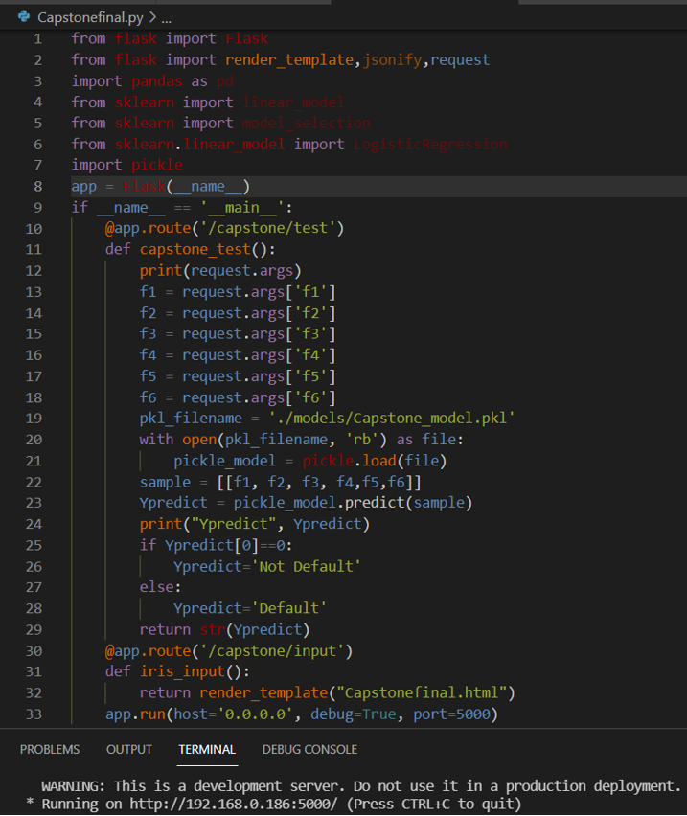
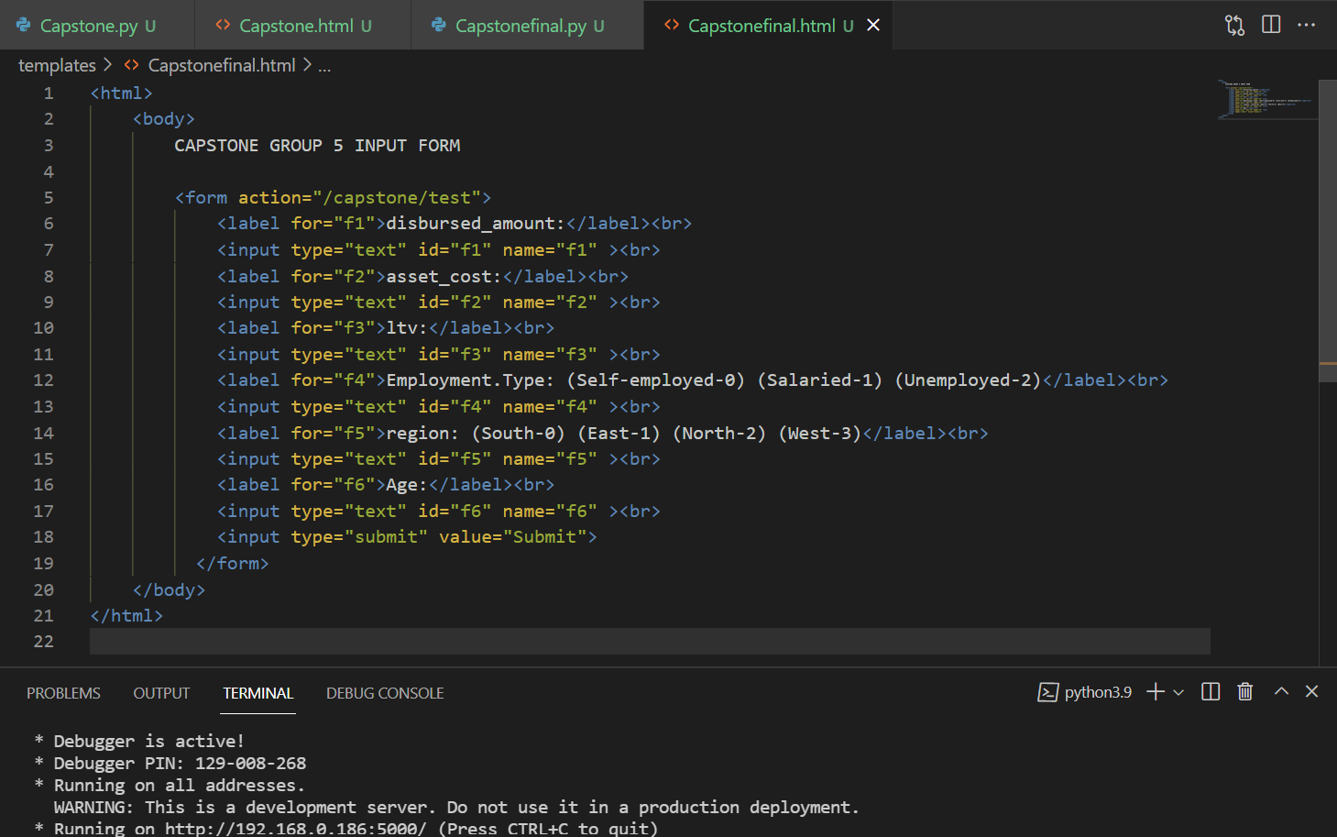
Deployment of model using Flask
HTML Form asking for user input

Slide 16
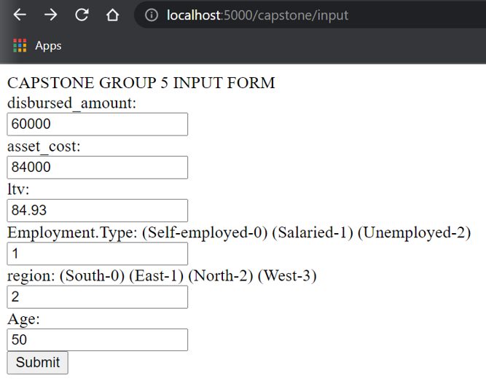
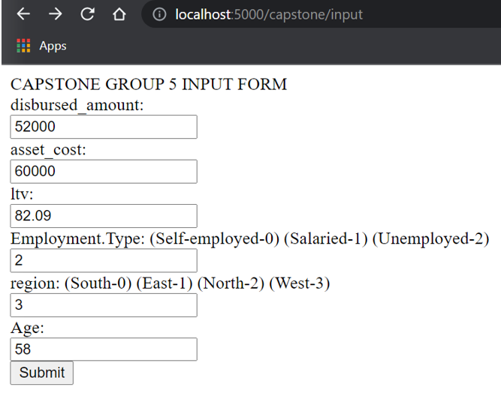
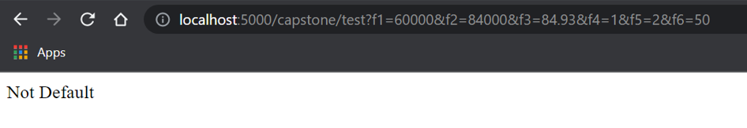
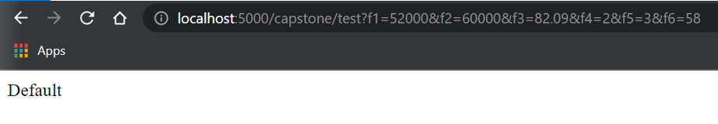
Input Form 1
Input Form 2
Output Form 1
Output Form 2

Slide 17
Thank You

